Slide 1
RUSTikales Rust for beginners
©Philippe Felix Haupt 2023-2024

Slide 2
Plan for today
©Philippe Felix Haupt 2023-2024

Slide 3
Plan for today
Recap
©Philippe Felix Haupt 2023-2024

Slide 4
Plan for today
Recap
Enums
©Philippe Felix Haupt 2023-2024

Slide 5
Plan for today
Recap
Enums
Pattern Matching
©Philippe Felix Haupt 2023-2024

Slide 6
Plan for today
Recap
Enums
Pattern Matching
match
let
©Philippe Felix Haupt 2023-2024

Slide 7
Recap
©Philippe Felix Haupt 2023-2024

Slide 8
Recap
Ownership-Model
Borrowing
Borrow Checker
©Philippe Felix Haupt 2023-2024

Slide 9
Recap
Ownership-Model
Borrowing
Borrow Checker
Structs
Associated functions, Methods
©Philippe Felix Haupt 2023-2024

Slide 10
Recap
Ownership-Model
Borrowing
Borrow Checker
Structs
Associated functions, Methods
Traits
Traits are contracts:
The Trait declares some functions
If you want to use the Trait, you need to define/implement all those functions
©Philippe Felix Haupt 2023-2024

Slide 11
Recap
Ownership-Model
Borrowing
Borrow Checker
Structs
Associated functions, Methods
Traits
Traits are contracts
Declared using the keyword trait
Implemented for a type by impl <trait_name> for <struct_name> { <functions> }
©Philippe Felix Haupt 2023-2024

Slide 12
Recap
Ownership-Model
Borrowing
Borrow Checker
Structs
Associated functions, Methods
Traits
Traits are contracts
Declared using the keyword trait
Implemented for a type by impl <trait_name> for <struct_name> { <functions> }
Traits allow us to generalize our code
Instead of wanting a specific type, we can accept anything that implements a given Trait
©Philippe Felix Haupt 2023-2024

Slide 13
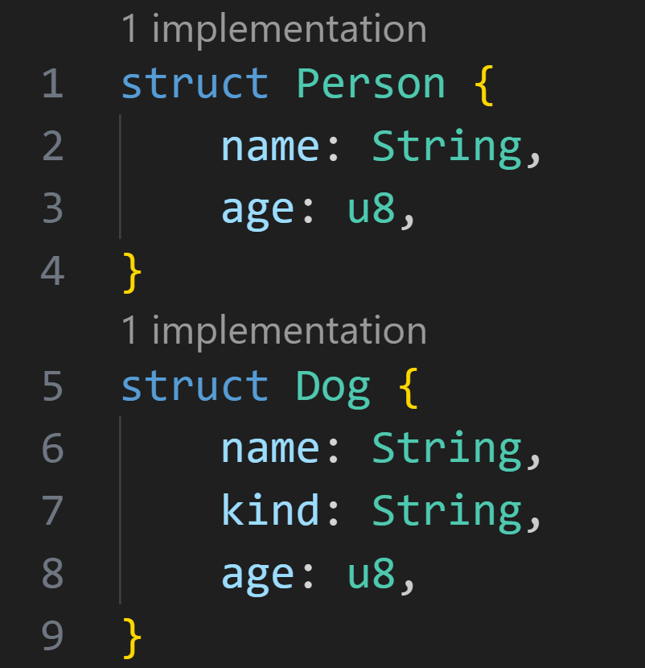
Recap
©Philippe Felix Haupt 2023-2024

Slide 14
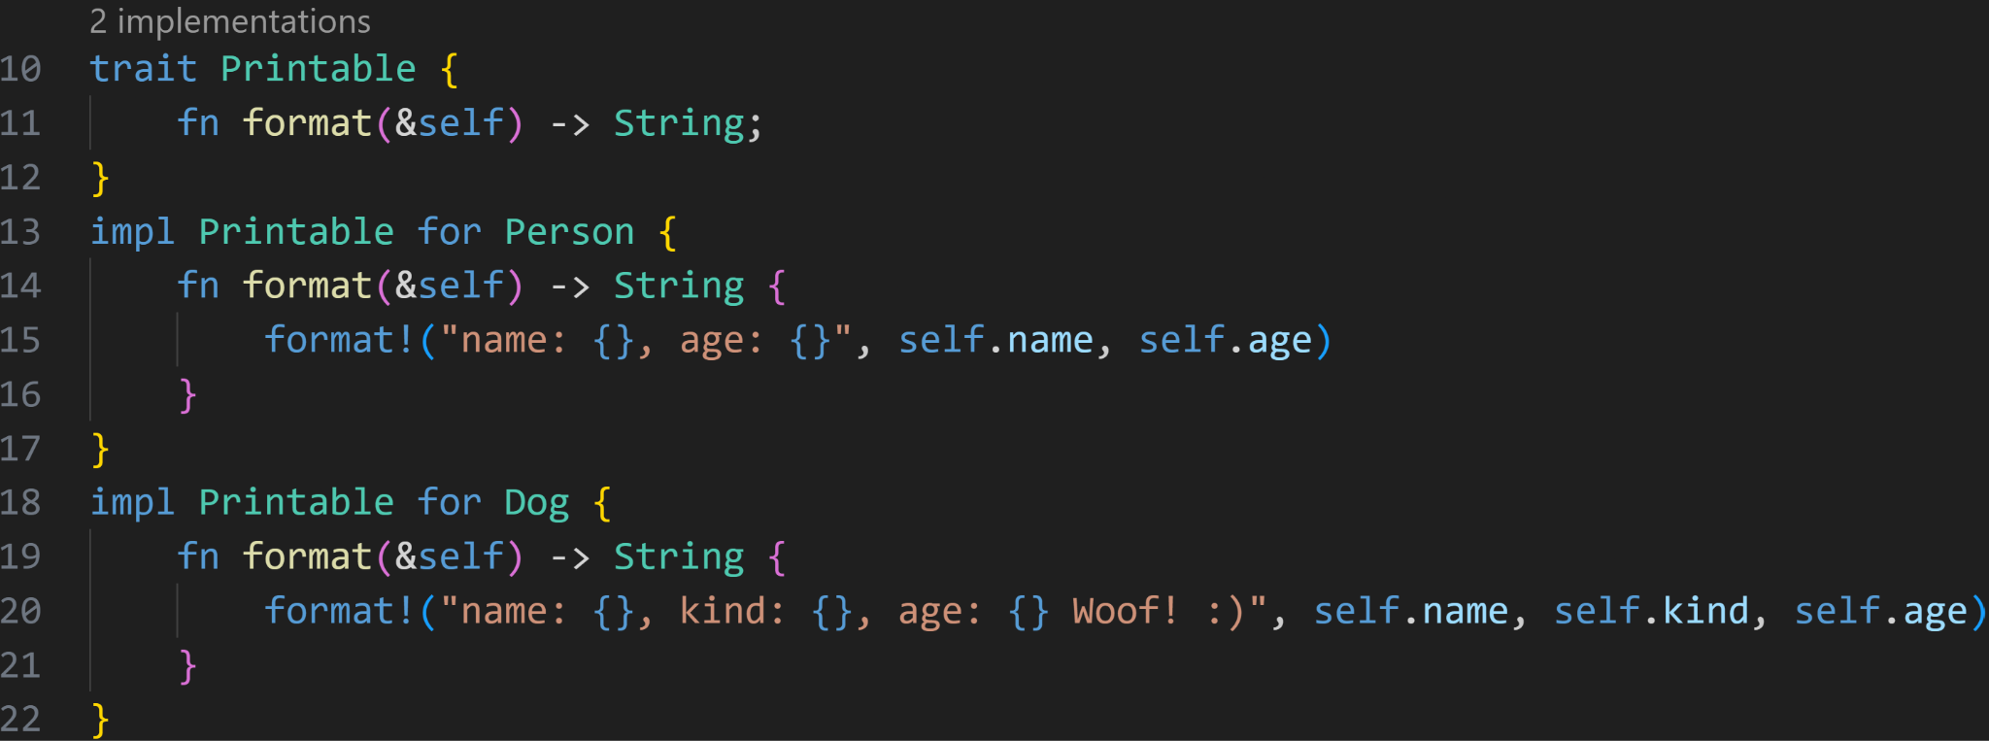
Recap
©Philippe Felix Haupt 2023-2024

Slide 15
Recap
Trait declaration
Trait implementations
©Philippe Felix Haupt 2023-2024

Slide 16
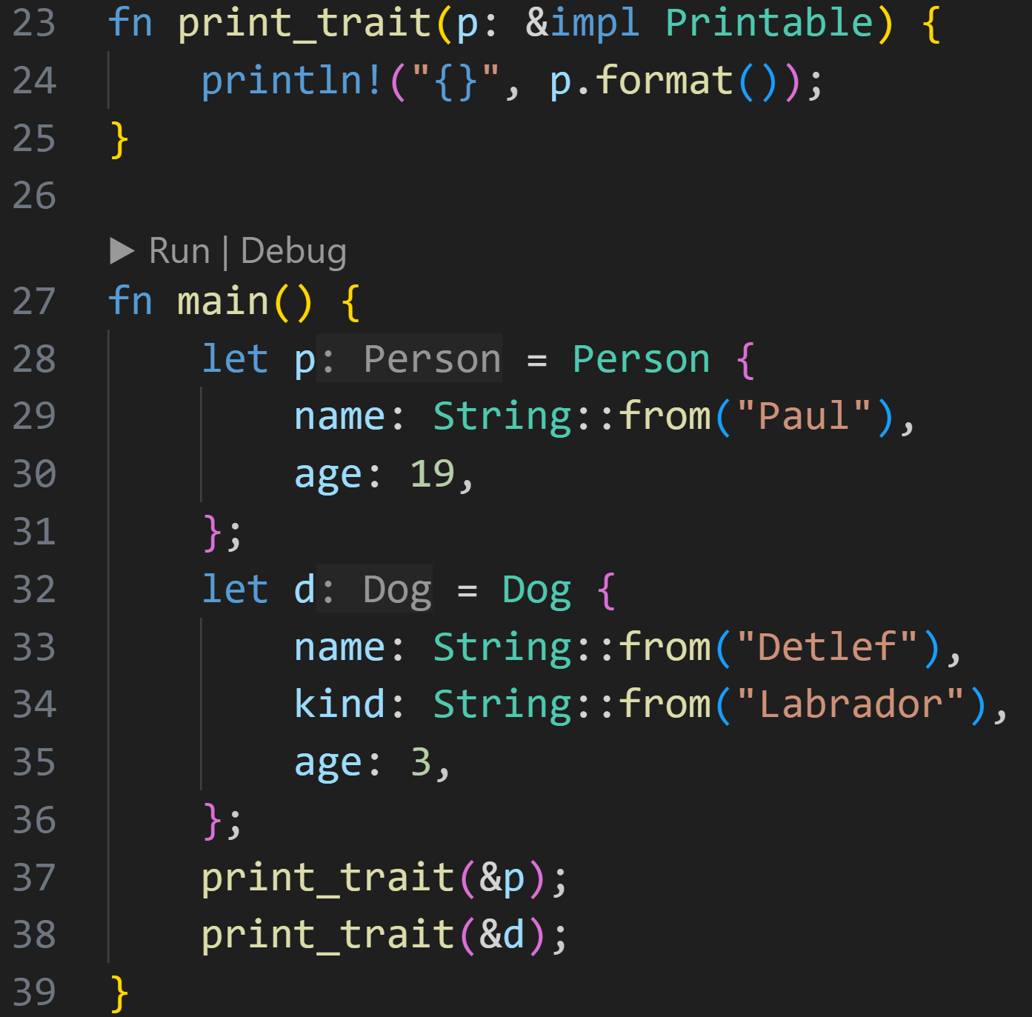
Recap
©Philippe Felix Haupt 2023-2024

Slide 17
Recap
We accept everything that implements that Printable-trait
©Philippe Felix Haupt 2023-2024

Slide 18
Recap
We accept everything that implements that Printable-trait
We can safely use the format-method inside the function, because the trait-contract says that Printable comes with format()
©Philippe Felix Haupt 2023-2024

Slide 19
Recap
We accept everything that implements that Printable-trait
Person and Dog both implement the Printable-trait
©Philippe Felix Haupt 2023-2024

Slide 20
Recap
We accept everything that implements that Printable-trait
Person and Dog both implement the Printable-trait
Can be passed as arguments to print_trait()
©Philippe Felix Haupt 2023-2024

Slide 21
Enums
©Philippe Felix Haupt 2023-2024

Slide 22
Enums
With functions, structs and even traits we can get very far, but there’s one more very useful tool we can utilize in Rust: enums
©Philippe Felix Haupt 2023-2024

Slide 23
Enums
With functions, structs and even traits we can get very far, but there’s one more very useful tool we can utilize in Rust: enums
Structs:
A way of grouping together related data
For example, a struct Point may contain a x-coordinate and a y-coordinate
©Philippe Felix Haupt 2023-2024

Slide 24
Enums
With functions, structs and even traits we can get very far, but there’s one more very useful tool we can utilize in Rust: enums
Structs:
A way of grouping together related data
For example, a struct Point may contain a x-coordinate and a y-coordinate
Enums:
A way of making a value be of a possible set of values
Because the set of values is finite, we can enumerate them, which is where the name enum comes from
For example, an enum Shape may be a Rectangle, or a Circle
©Philippe Felix Haupt 2023-2024

Slide 25
Enums
With functions, structs and even traits we can get very far, but there’s one more very useful tool we can utilize in Rust: enums
Structs:
A way of grouping together related data
For example, a struct Point may contain a x-coordinate and a y-coordinate
Enums:
A way of making a value be of a possible set of values
Because the set of values is finite, we can enumerate them, which is where the name enum comes from
For example, an enum Shape may be a Rectangle, or a Circle
Declared in Rust using the keyword enum
©Philippe Felix Haupt 2023-2024

Slide 26
Enums
With functions, structs and even traits we can get very far, but there’s one more very useful tool we can utilize in Rust: enums
Structs:
A way of grouping together related data
For example, a struct Point may contain a x-coordinate and a y-coordinate
Enums:
A way of making a value be of a possible set of values
Because the set of values is finite, we can enumerate them, which is where the name enum comes from
For example, an enum Shape may be a Rectangle, or a Circle
Declared in Rust using the keyword enum
Enum values can be used using the syntax <enum_name>::<enum_value>
©Philippe Felix Haupt 2023-2024

Slide 27
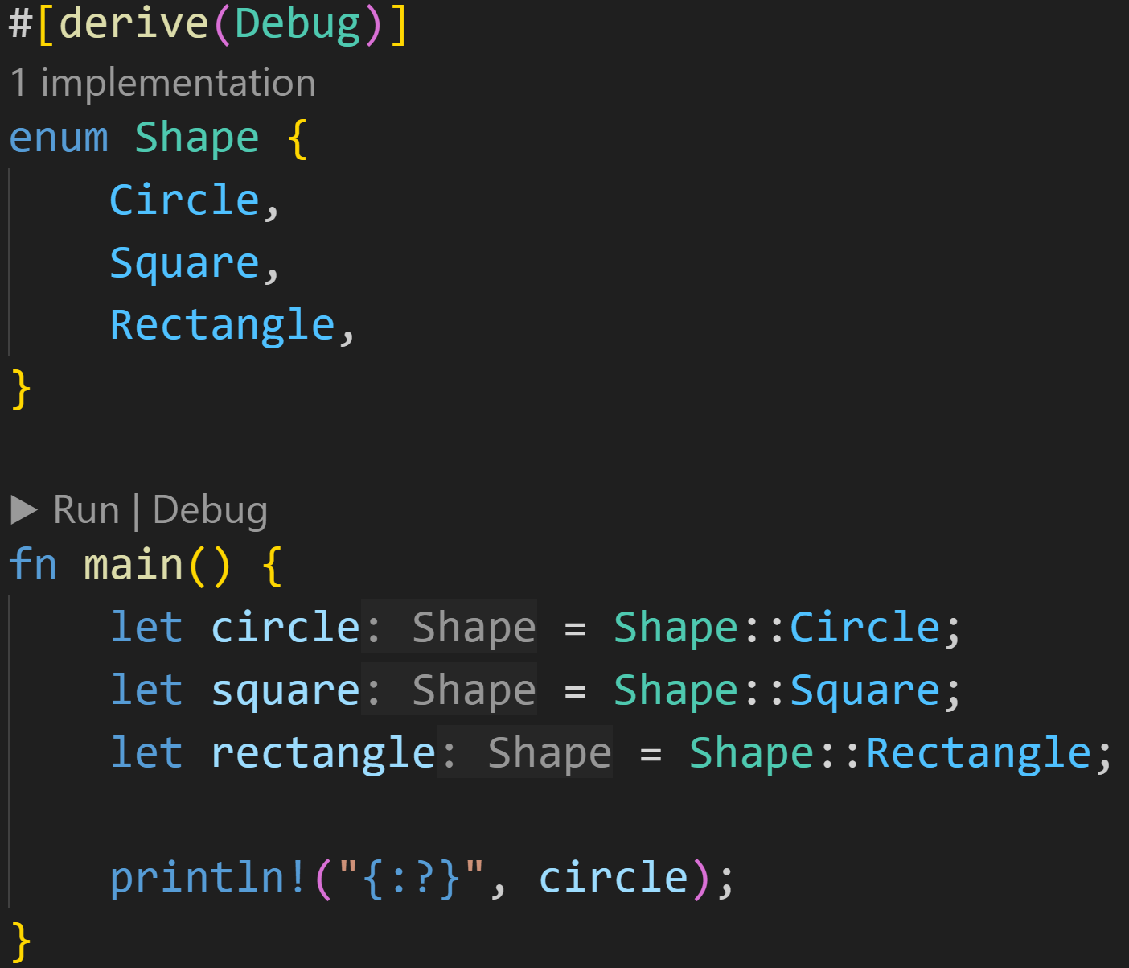
Enums
©Philippe Felix Haupt 2023-2024

Slide 28
Enums
Declare an enum Shape, with one of 3 possible values: Circle, Square, Rectangle
©Philippe Felix Haupt 2023-2024

Slide 29
Enums
Declare an enum Shape, with one of 3 possible values: Circle, Square, Rectangle
Use the Enum values
©Philippe Felix Haupt 2023-2024

Slide 30
Enums
We can also implement Traits for enums, more on that shortly
©Philippe Felix Haupt 2023-2024

Slide 31
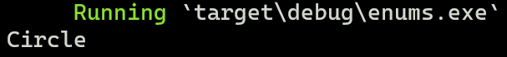
Enums
©Philippe Felix Haupt 2023-2024

Slide 32
Enums
Enums are type definitions too
©Philippe Felix Haupt 2023-2024

Slide 33
Enums
As seen in the previous slide, Enums are type definitions, which means:
They can be used as parameter and variable types
They can be used as struct fields
etc.
©Philippe Felix Haupt 2023-2024

Slide 34
Enums
As seen in the previous slide, Enums are type definitions, which means:
They can be used as parameter and variable types
They can be used as struct fields
etc.
In our example that means we can pass Shape-values around and do stuff with them
©Philippe Felix Haupt 2023-2024

Slide 35
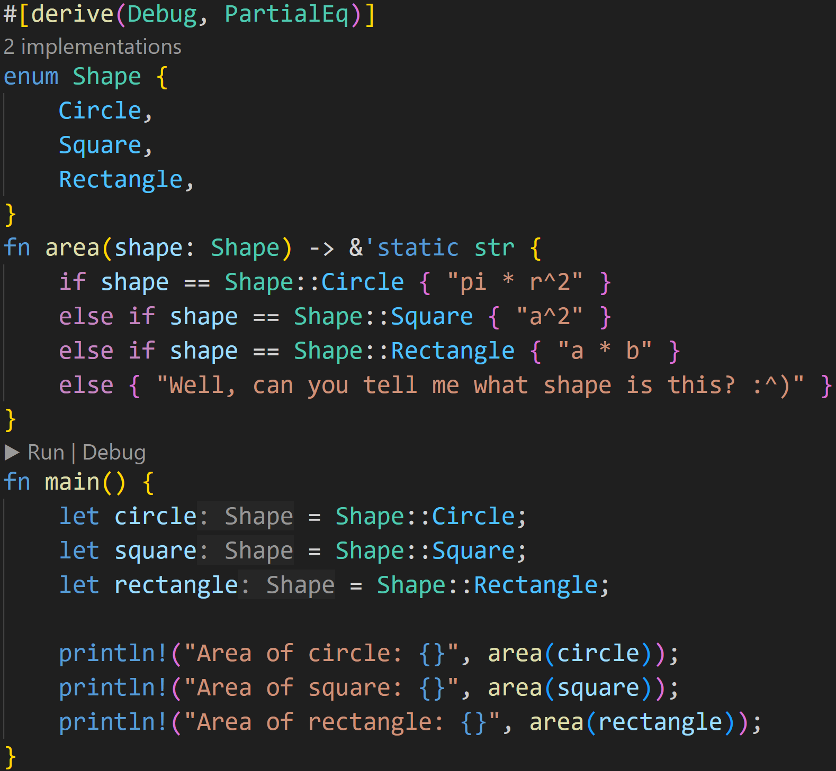
Enums
©Philippe Felix Haupt 2023-2024

Slide 36
Enums
We can do stuff with variables of type Shape, here we get the formula for the area of the given Shape type
©Philippe Felix Haupt 2023-2024

Slide 37
Enums
We can pass Enums as arguments
©Philippe Felix Haupt 2023-2024

Slide 38
Enums
PartialEq is required for ==
©Philippe Felix Haupt 2023-2024

Slide 39
Enums
2/3
Will Rust ever get to the last else?
©Philippe Felix Haupt 2023-2024

Slide 40
Enums
2/3
Will Rust ever get to the last else?
No, it won’t :)
We know what Shape can be, and we handle all of them before the else
shape will only ever be one of
Shape::Circle
Shape::Square
Shape::Rectangle
©Philippe Felix Haupt 2023-2024

Slide 41
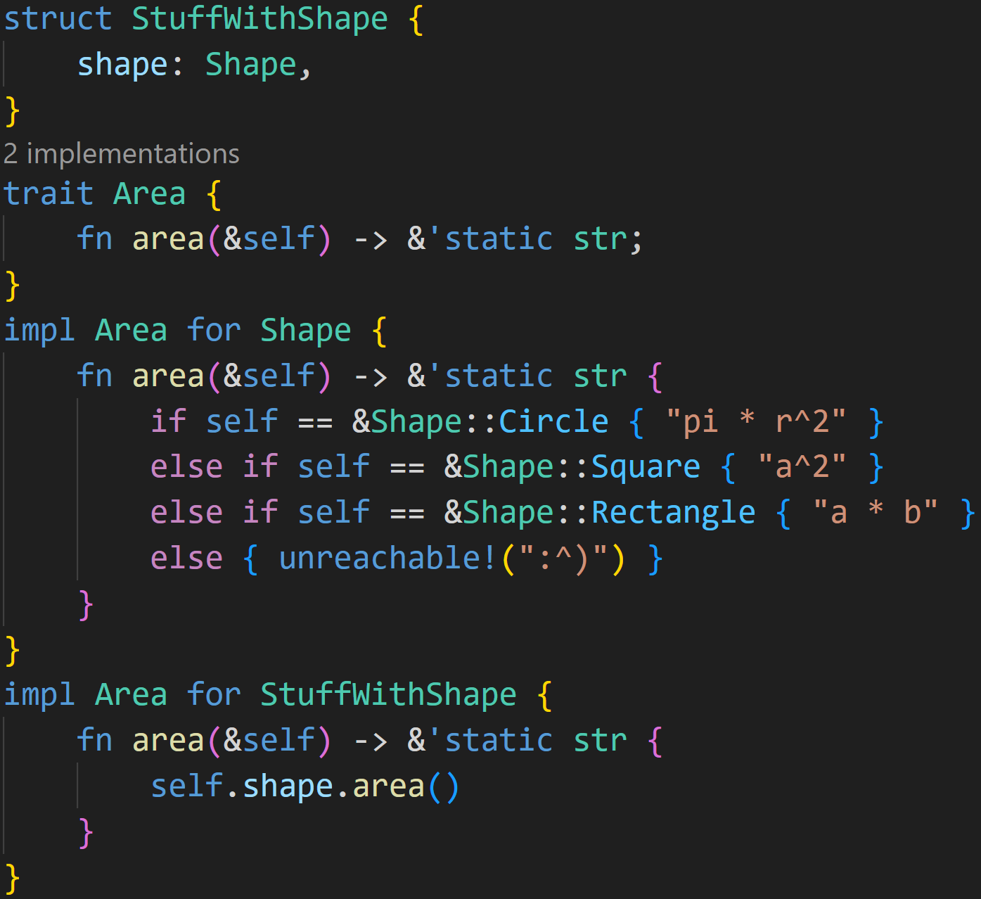
Enums
Additionally, we can implement Traits on Enums, and use Enums as struct fields
©Philippe Felix Haupt 2023-2024

Slide 42
Enums
use as struct field
©Philippe Felix Haupt 2023-2024

Slide 43
Enums
use as struct field
implement a trait for our Enum
©Philippe Felix Haupt 2023-2024

Slide 44
Enums
use as struct field
implement a trait for our Enum
We can call area() because we implemented the trait!
©Philippe Felix Haupt 2023-2024

Slide 45
Enums
unreachable!() is a macro that helps the compiler optimize stuff, it panics if it actually gets there in runtime, but as we showed:
it won’t get there :)
©Philippe Felix Haupt 2023-2024

Slide 46
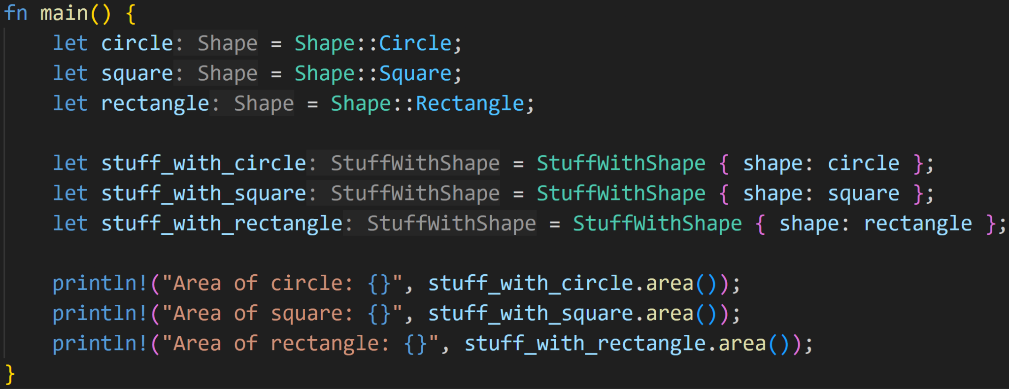
Enums
©Philippe Felix Haupt 2023-2024

Slide 47
Enums
Normal rules apply: Our values are moved here
©Philippe Felix Haupt 2023-2024

Slide 48
Enums
Currently, we have no way to actually store any data in those Shapes, we only know what kind they are → We still need structs
©Philippe Felix Haupt 2023-2024

Slide 49
Enums
Currently, we have no way to actually store any data in those Shapes, we only know what kind they are → We still need structs → Even worse, those Shapes are incompatible, we need several structs → Circle has Radius and Center → Rectangle has Width and Height → Can’t conveniently be stored in one struct
©Philippe Felix Haupt 2023-2024

Slide 50
Enums
Currently, we have no way to actually store any data in those Shapes, we only know what kind they are → We still need structs → Even worse, those Shapes are incompatible, we need several structs → Circle has Radius and Center → Rectangle has Width and Height → Can’t conveniently be stored in one struct
For this, Rust allows you to attach data to Enums directly
©Philippe Felix Haupt 2023-2024

Slide 51
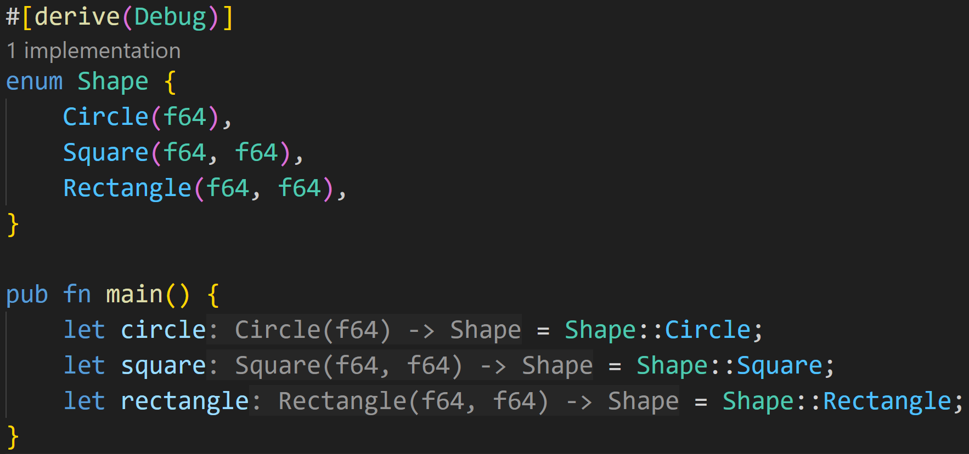
Enums
©Philippe Felix Haupt 2023-2024

Slide 52
Enums
We can attach some data to our enum, here we tell Rust:
Circles come with one float (radius)
Squares come with two floats (width and height)
Rectangles come with two floats too (width and height)
©Philippe Felix Haupt 2023-2024

Slide 53
Enums
Shape::Circle is now a function, not a simple Enum-Value :)
This is because we haven’t provided a float
©Philippe Felix Haupt 2023-2024

Slide 54
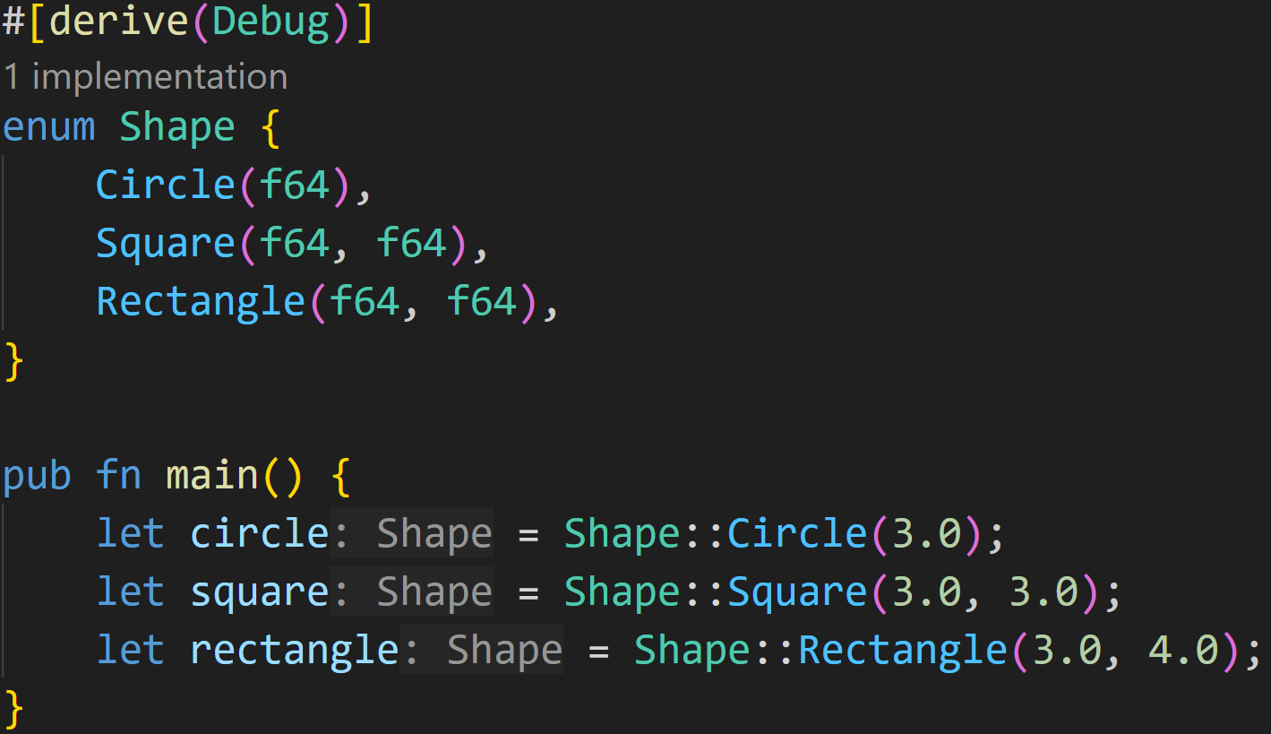
Enums
We provided data, it’s fixed now :)
©Philippe Felix Haupt 2023-2024

Slide 55
Enums
Creates a Shape of type Circle, with attached data = 3.0
©Philippe Felix Haupt 2023-2024

Slide 56
Enums
After creating the Shape, setting and getting those values is more involved… :^)
©Philippe Felix Haupt 2023-2024

Slide 57
Pattern Matching - match
Now that we have associated data with our Enum, many things suddenly become way harder
©Philippe Felix Haupt 2023-2024

Slide 58
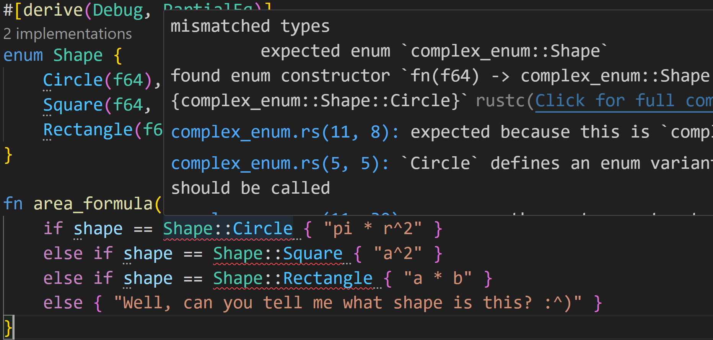
Pattern Matching - match
©Philippe Felix Haupt 2023-2024

Slide 59
Pattern Matching - match
What does this error mean?
The left hand side of the comparison is a Shape, the right hand side is a function, can’t compare that
©Philippe Felix Haupt 2023-2024

Slide 60
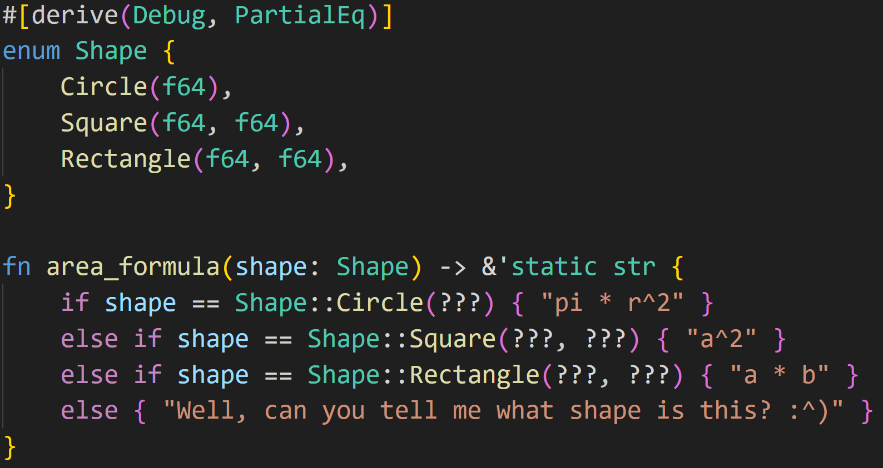
Pattern Matching - match
Okay then, let’s construct some Shapes that can be compared
©Philippe Felix Haupt 2023-2024

Slide 61

Pattern Matching - match
Okay then, let’s construct some Shapes that can be compared
Uhh… What do we put in there?
©Philippe Felix Haupt 2023-2024

Slide 62
Pattern Matching - match
Okay then, let’s construct some Shapes that can be compared
Uhh… What do we put in there?
This is a non-trivial task, we can’t put *all* floats in there :(
©Philippe Felix Haupt 2023-2024

Slide 63
Pattern Matching - match
Actually, all we care about is that the Enum kind matches, we do not necessarily care about the associated float (in this case)
©Philippe Felix Haupt 2023-2024

Slide 64
Pattern Matching - match
Actually, all we care about is that the Enum kind matches, we do not necessarily care about the associated float (in this case)
For situations like this, Rust has a control flow construct, called match
©Philippe Felix Haupt 2023-2024

Slide 65
Pattern Matching - match
Actually, all we care about is that the Enum kind matches, we do not necessarily care about the associated float (in this case)
For situations like this, Rust has a control flow construct, called match
match uses Rust’s powerful Pattern Matching mechanism to figure out what to execute
©Philippe Felix Haupt 2023-2024

Slide 66
Pattern Matching - match
Actually, all we care about is that the Enum kind matches, we do not necessarily care about the associated float (in this case)
For situations like this, Rust has a control flow construct, called match
match uses Rust’s powerful Pattern Matching mechanism to figure out what to execute
match is exhaustive, meaning all possible patterns need to be matched
©Philippe Felix Haupt 2023-2024

Slide 67
Pattern Matching - match
Actually, all we care about is that the Enum kind matches, we do not necessarily care about the associated float (in this case)
For situations like this, Rust has a control flow construct, called match
match uses Rust’s powerful Pattern Matching mechanism to figure out what to execute
match is exhaustive, meaning all possible patterns need to be matched
There are two types of patterns in Rust:
Refutable → Pattern can fail to match for possible values
Irrefutable → Pattern will always match for any possible value
©Philippe Felix Haupt 2023-2024

Slide 68
Pattern Matching - match
Actually, all we care about is that the Enum kind matches, we do not necessarily care about the associated float (in this case)
For situations like this, Rust has a control flow construct, called match
match uses Rust’s powerful Pattern Matching mechanism to figure out what to execute
match is exhaustive, meaning all possible patterns need to be matched
There are two types of patterns in Rust:
Refutable → Pattern can fail to match for possible values
Irrefutable → Pattern will always match for any possible value
There are several kinds of patterns that can be matched:
Literals
Destructured Arrays, Structs, Enums, etc
Variables
Wildcards
Placeholders
©Philippe Felix Haupt 2023-2024

Slide 69
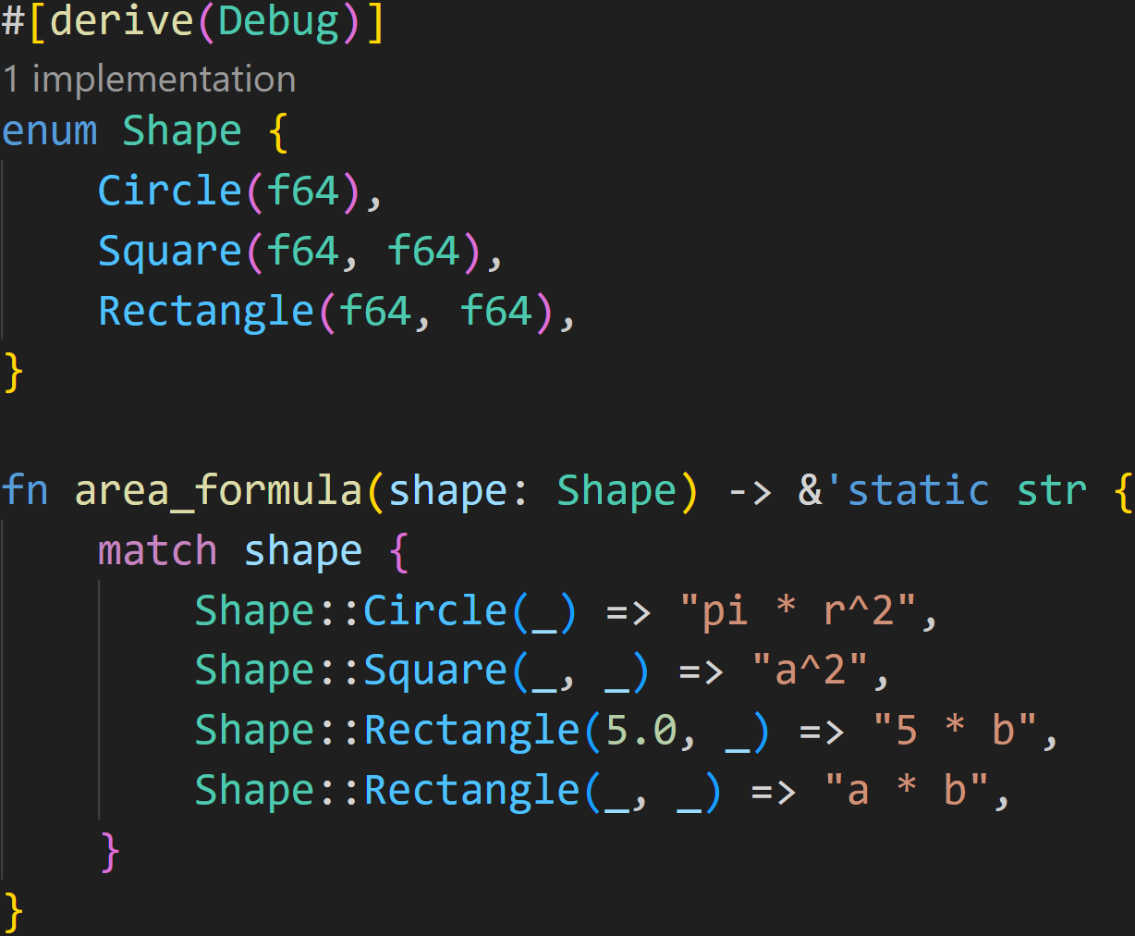
Pattern Matching - match
©Philippe Felix Haupt 2023-2024

Slide 70
Pattern Matching - match
Pattern
What to do if pattern matches
©Philippe Felix Haupt 2023-2024

Slide 71
Pattern Matching - match
This matches if the original shape is a Circle
©Philippe Felix Haupt 2023-2024

Slide 72
Pattern Matching - match
_ is the Wildcard pattern and matches everything, here it means we match every radius
This matches if the original shape is a Circle
©Philippe Felix Haupt 2023-2024

Slide 73
Pattern Matching - match
This matches if the original shape is a Rectangle AND the first float is 5.0
©Philippe Felix Haupt 2023-2024

Slide 74
Pattern Matching - match
This matches if the original shape is a Rectangle AND the first float is 5.0
Patterns are evaluated top to bottom, so if the top Rectangle matches, it will not check the bottom Rectangle
©Philippe Felix Haupt 2023-2024

Slide 75
Pattern Matching - match
match is exhaustive, so we need to handle all possible patterns that may occur, which is the case here, because:
All circles are matched in the first branch
All squares are matched in the second branch
All rectangles are matched after that
We don’t have any more Shapes, so we’re done
©Philippe Felix Haupt 2023-2024

Slide 76
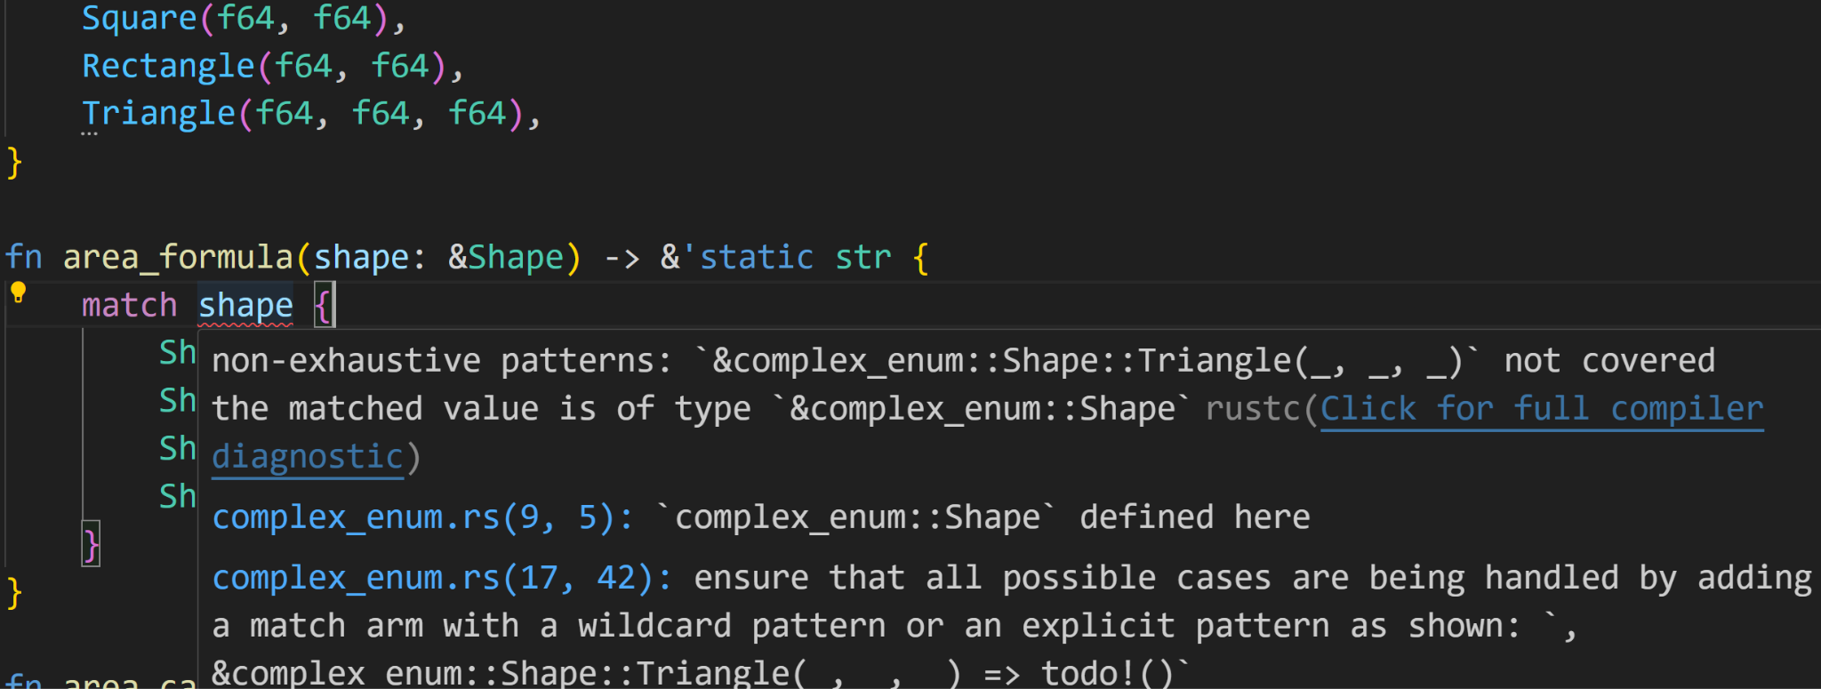
Pattern Matching - match
Add a new shape
©Philippe Felix Haupt 2023-2024

Slide 77
Pattern Matching - match
Add a new shape
©Philippe Felix Haupt 2023-2024

Slide 78
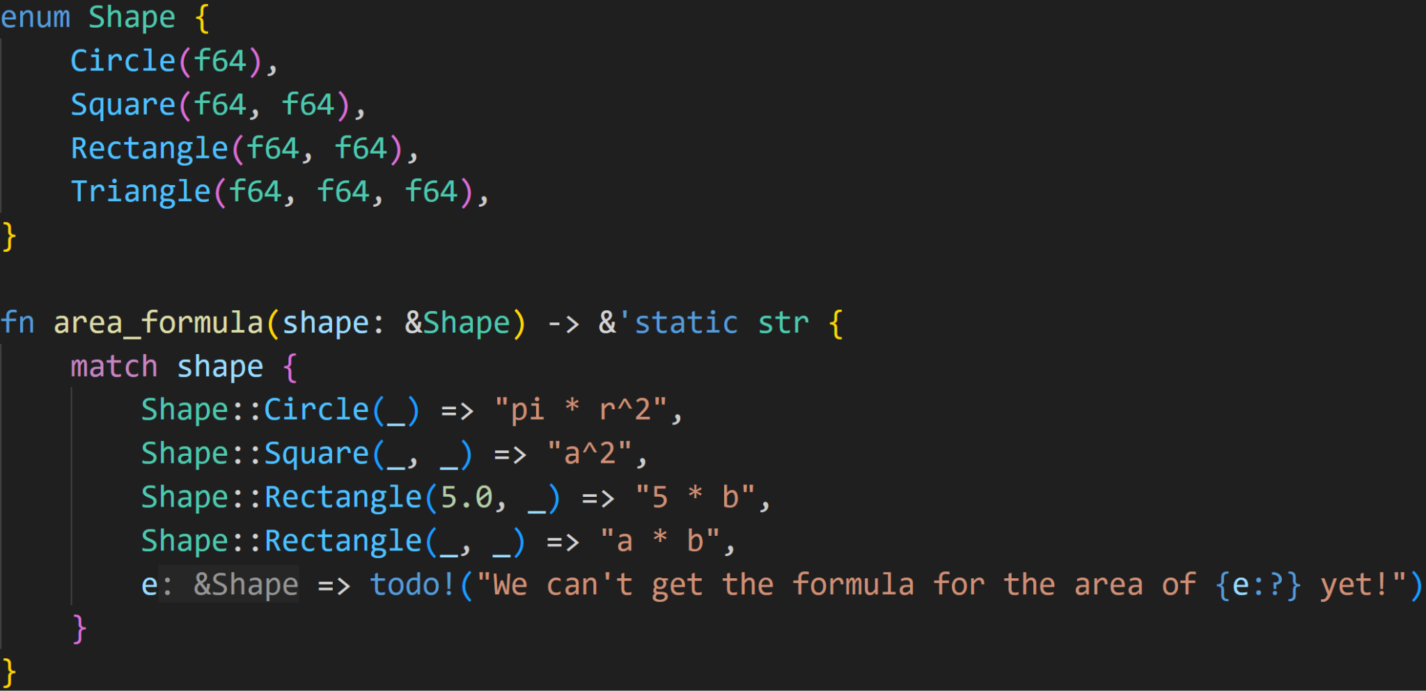
Pattern Matching - match
©Philippe Felix Haupt 2023-2024

Slide 79
Pattern Matching - match
This is an irrefutable pattern and binds the value of shape to the variable e
©Philippe Felix Haupt 2023-2024

Slide 80
Pattern Matching - match
e is only valid in this code block Here: Only for that todo! macro
©Philippe Felix Haupt 2023-2024

Slide 81
Pattern Matching - match
©Philippe Felix Haupt 2023-2024

Slide 82
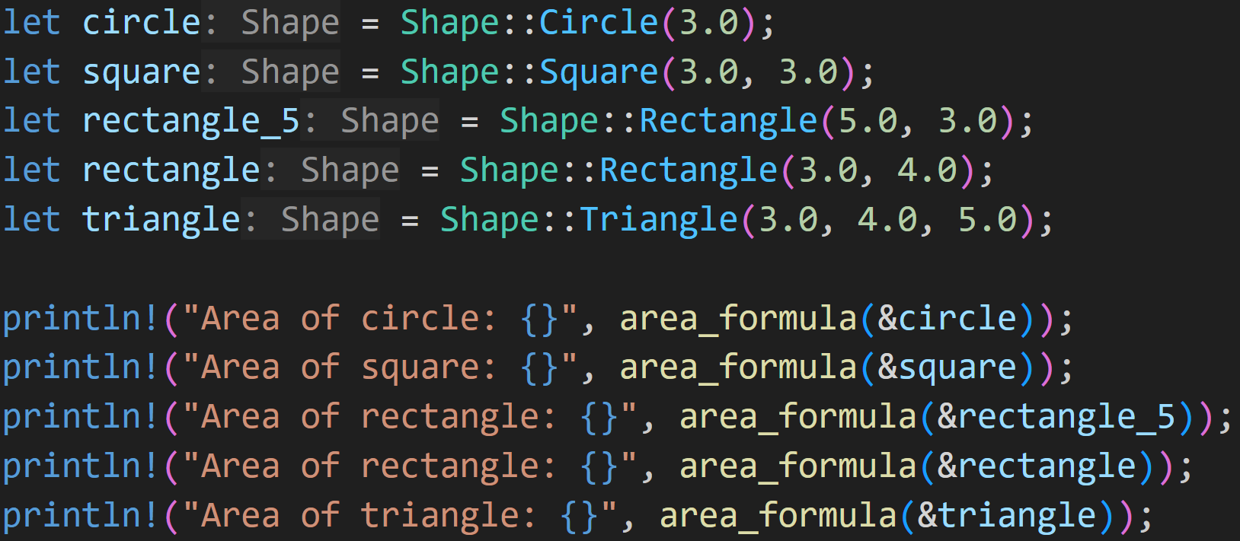
Pattern Matching - match
©Philippe Felix Haupt 2023-2024

Slide 83
Pattern Matching - match
2/3
What’s the output?
©Philippe Felix Haupt 2023-2024

Slide 84
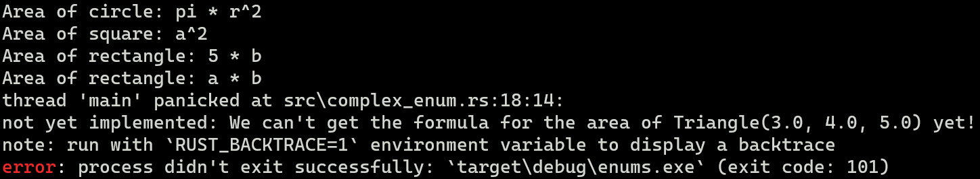
Pattern Matching - match
Output:
©Philippe Felix Haupt 2023-2024

Slide 85
Pattern Matching - match
Output:
Because the first float is 5.0, it returns a different string!
©Philippe Felix Haupt 2023-2024

Slide 86
Pattern Matching - match
Output:
todo!
The value e matched
©Philippe Felix Haupt 2023-2024

Slide 87
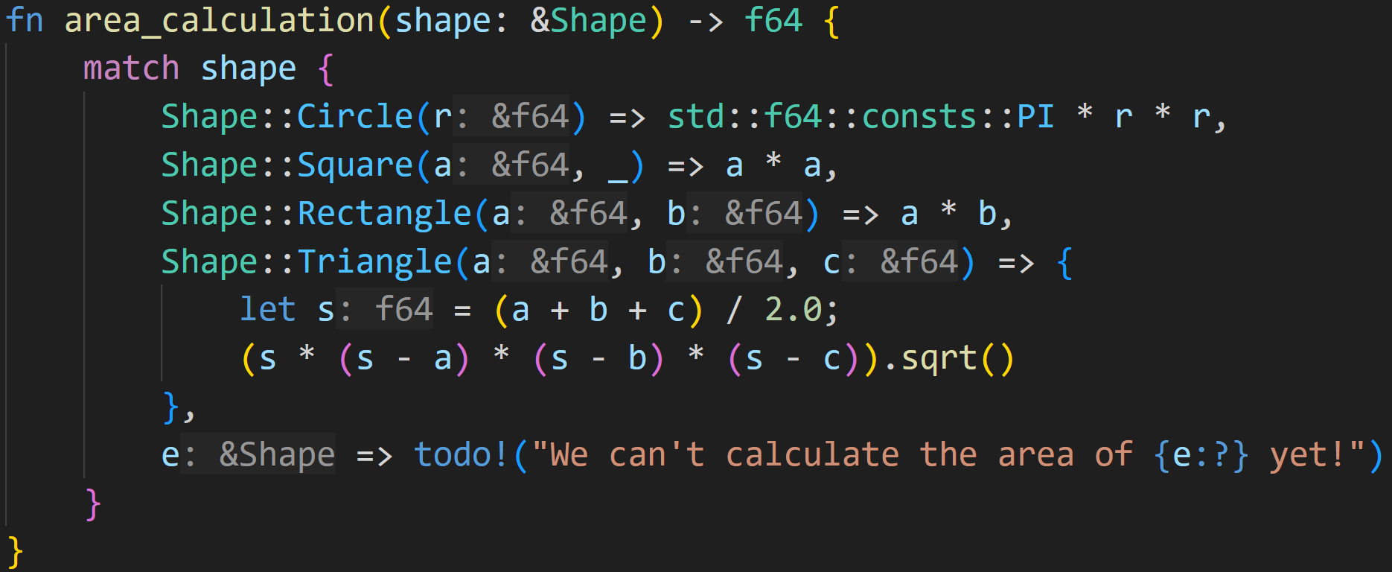
Pattern Matching - match
©Philippe Felix Haupt 2023-2024

Slide 88
Pattern Matching - match
bind values to a, b and c
©Philippe Felix Haupt 2023-2024

Slide 89
Pattern Matching - match
bind values to a, b and c
you can now use them in this block
©Philippe Felix Haupt 2023-2024

Slide 90
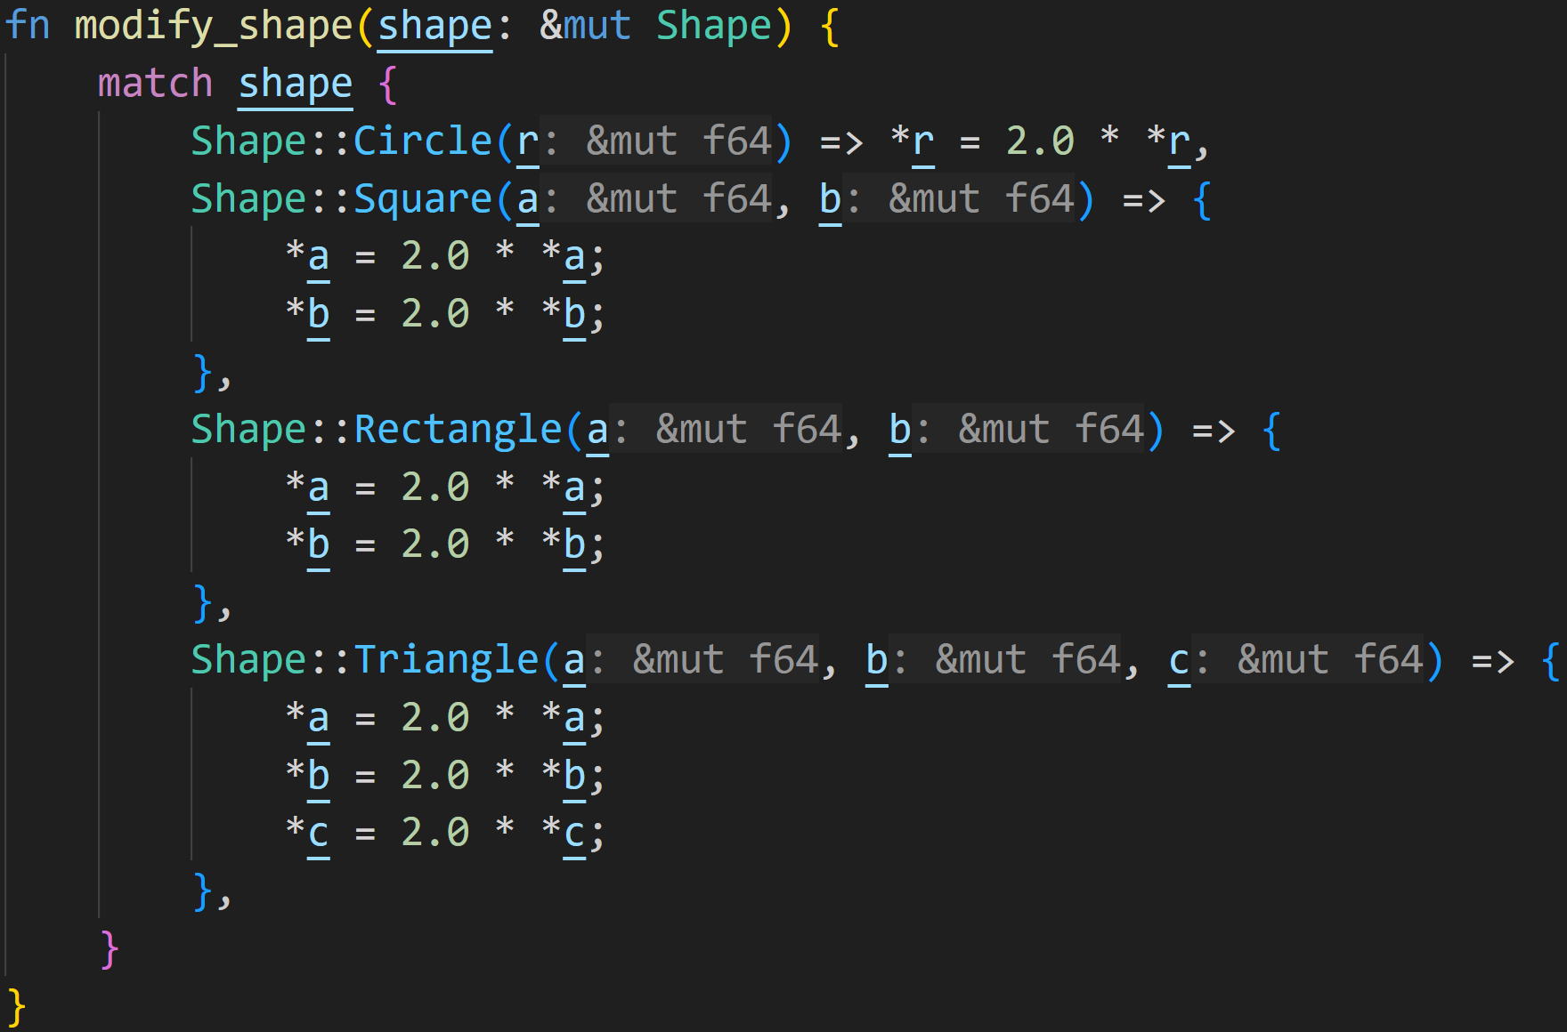
Pattern Matching - match
Using match, you can also modify the original Enum variant
©Philippe Felix Haupt 2023-2024

Slide 91
Pattern Matching - match
Using match, you can also modify the original Enum variant
Every branch updates the original shape (notice the mut)
©Philippe Felix Haupt 2023-2024

Slide 92
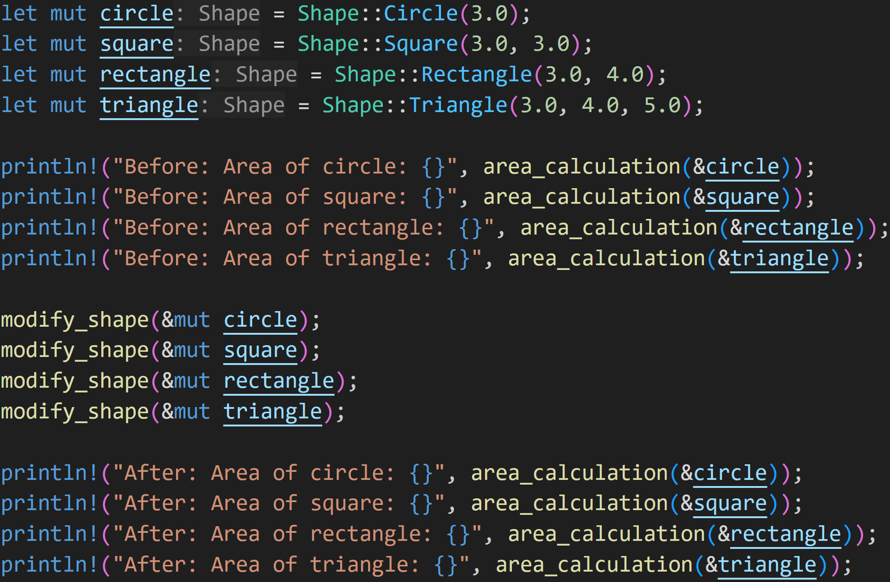
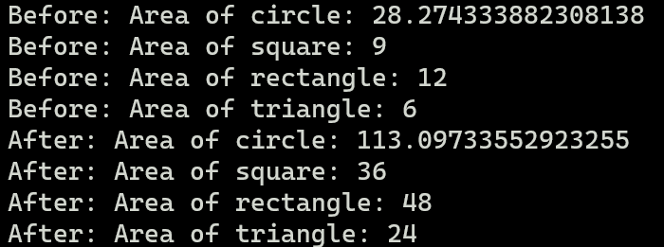
Pattern Matching - match
©Philippe Felix Haupt 2023-2024

Slide 93
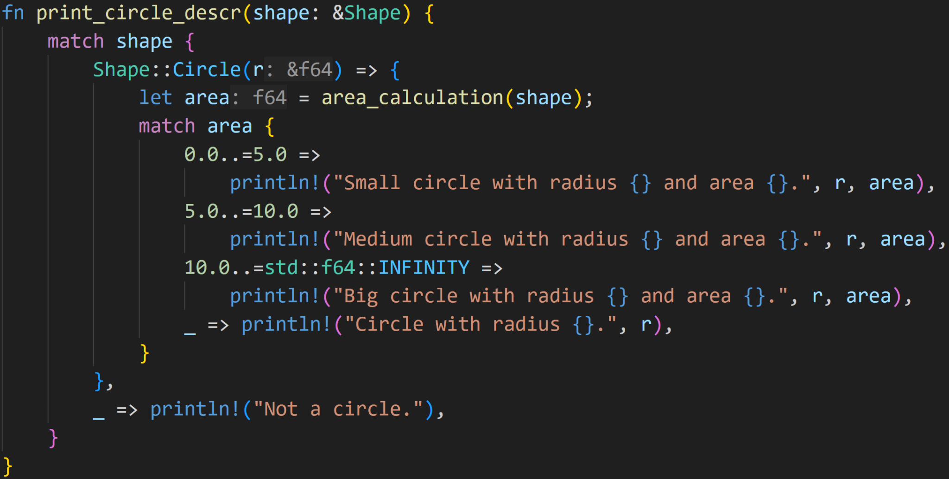
Pattern Matching - match
As with all control flow constructs, you can also nest match
©Philippe Felix Haupt 2023-2024

Slide 94
Pattern Matching - match
Ranges are valid patterns, the program will enter this path if the area is between 0 and 5 (both inclusive)
©Philippe Felix Haupt 2023-2024

Slide 95
Pattern Matching - match
1/3
Ranges are valid patterns, the program will enter this path if the area is between 0 and 5 (both inclusive)
Will we ever get here?
©Philippe Felix Haupt 2023-2024

Slide 96
Pattern Matching - match
1/3
Ranges are valid patterns, the program will enter this path if the area is between 0 and 5 (both inclusive)
Will we ever get here?
No, because that’d mean the area is negative :)
©Philippe Felix Haupt 2023-2024

Slide 97
Pattern Matching - match
Hmm, this looks very cluttered, a lot of indentation for not much work, can we do better?
©Philippe Felix Haupt 2023-2024

Slide 98
Pattern Matching - let
Rust loves its Pattern Matching, so much so that basically everything is a Pattern :)
©Philippe Felix Haupt 2023-2024

Slide 99
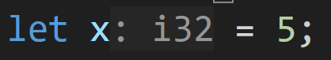
Pattern Matching - let
Rust loves its Pattern Matching, so much so that basically everything is a Pattern :)
©Philippe Felix Haupt 2023-2024

Slide 100
Pattern Matching - let
Rust loves its Pattern Matching, so much so that basically everything is a Pattern :)
let is also matching a Pattern:
Remember that match-arm where we matched with a variable name?
This is exactly what happens here: The Pattern x is irrefutable, so Rust matches 5 onto x :)
©Philippe Felix Haupt 2023-2024

Slide 101
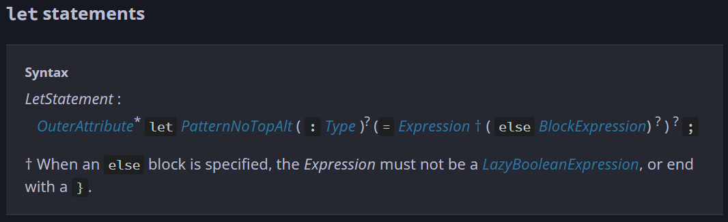
Pattern Matching - let
Rust loves its Pattern Matching, so much so that basically everything is a Pattern :)
let is also matching a Pattern:
©Philippe Felix Haupt 2023-2024

Slide 102
Pattern Matching - let
Rust loves its Pattern Matching, so much so that basically everything is a Pattern :)
* means 0 or more times ? means 0 or 1 time
None
None
None
©Philippe Felix Haupt 2023-2024

Slide 103
Pattern Matching - let
Rust loves its Pattern Matching, so much so that basically everything is a Pattern :)
Pattern spotted :)
©Philippe Felix Haupt 2023-2024

Slide 104
Pattern Matching - let
Rust loves its Pattern Matching, so much so that basically everything is a Pattern :)
What does this mean for us?
Well, we can also match our Enum using let, if we only care about a single variant
©Philippe Felix Haupt 2023-2024

Slide 105
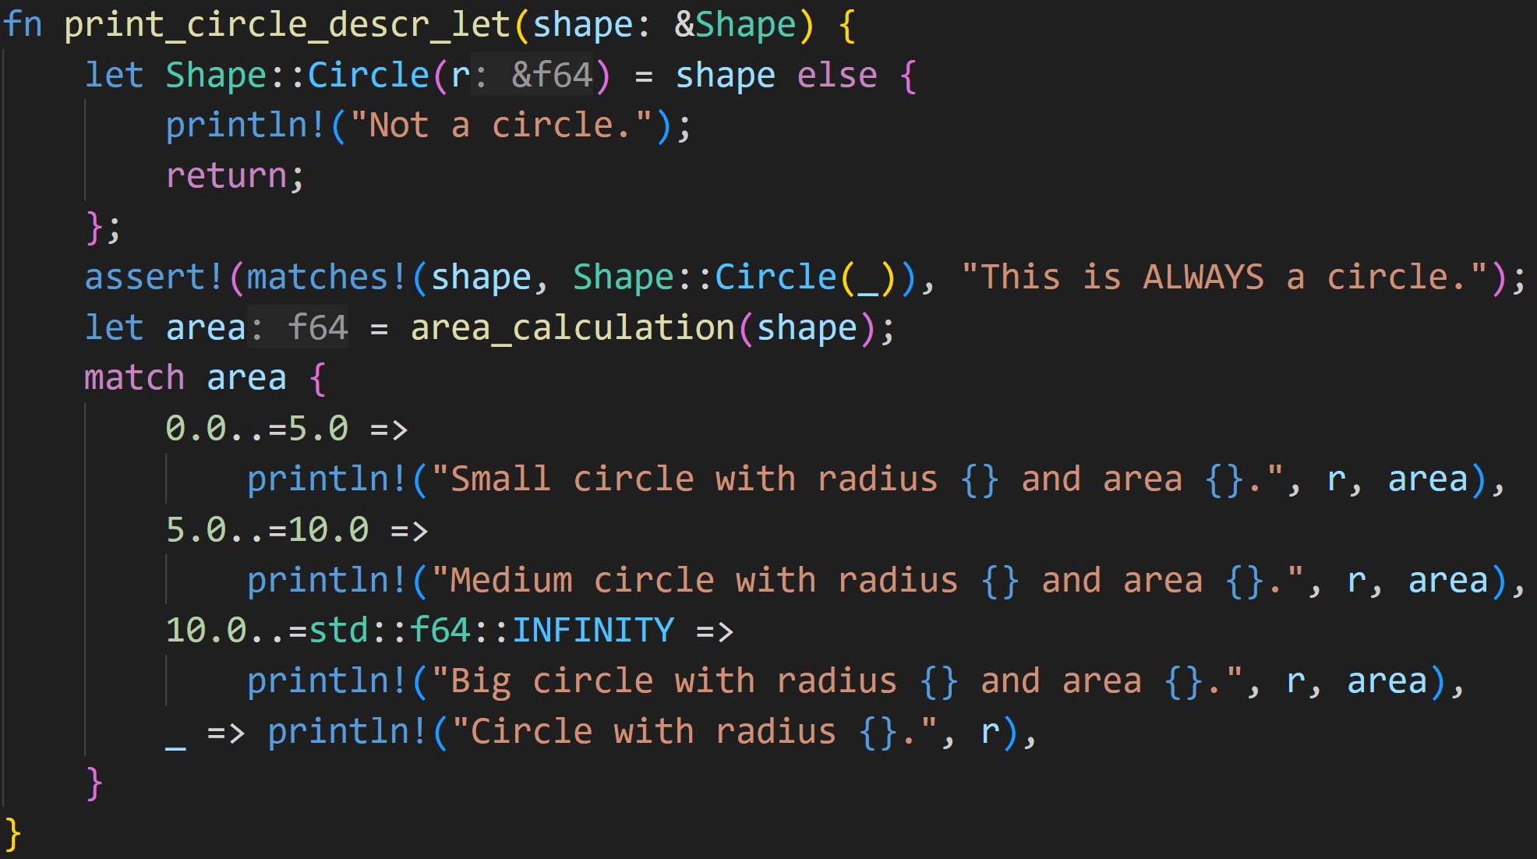
Pattern Matching - let
©Philippe Felix Haupt 2023-2024

Slide 106
Pattern Matching - let
tries to match shape with Shape::Circle, otherwise executes the else-branch
©Philippe Felix Haupt 2023-2024

Slide 107
Pattern Matching - let
tries to match shape with Shape::Circle, otherwise executes the else-branch
We can save some indentation here now
©Philippe Felix Haupt 2023-2024

Slide 108
Pattern Matching - let
tries to match shape with Shape::Circle, otherwise executes the else-branch
Normally you’d also use a normal if-else chain for this
©Philippe Felix Haupt 2023-2024

Slide 109
Intermission - Exercise
Time for exercises!
©Philippe Felix Haupt 2023-2024

Slide 110
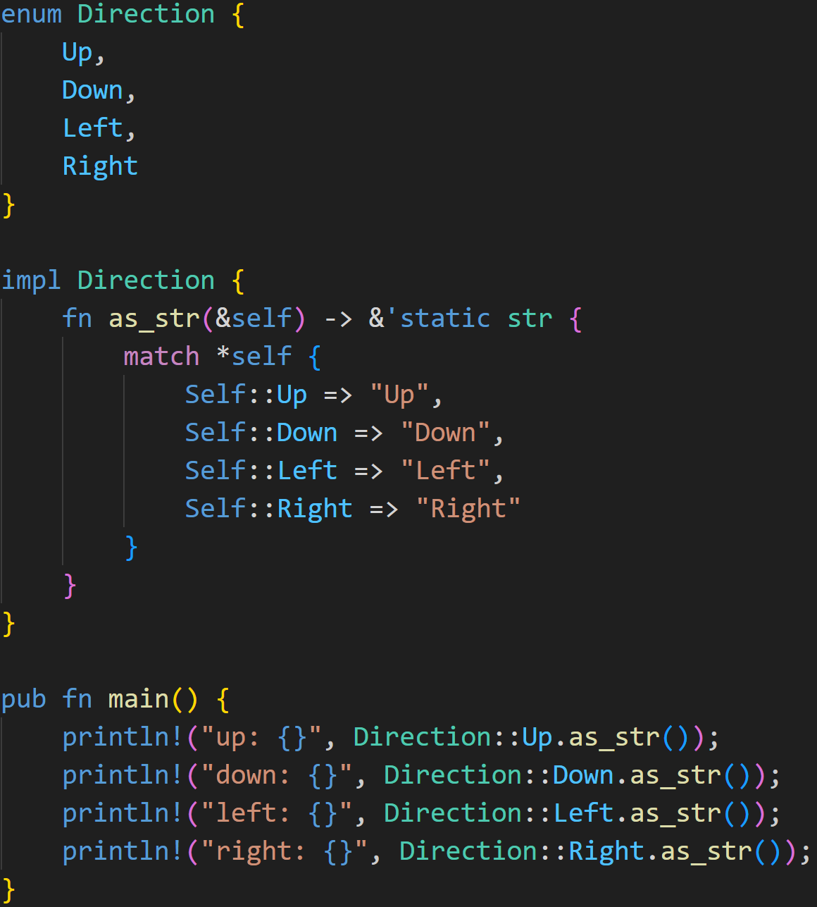
1/3
©Philippe Felix Haupt 2023-2024

Slide 111
1/3
Does this example compile?
If yes, what does it print?
©Philippe Felix Haupt 2023-2024

Slide 112
1/3
Does this example compile?
If yes, what does it print?
Simple Enum Direction with 4 Variants
©Philippe Felix Haupt 2023-2024

Slide 113
1/3
Does this example compile?
If yes, what does it print?
Simple Enum Direction with 4 Variants
match is exhaustive, it covers all 4 Variants
©Philippe Felix Haupt 2023-2024

Slide 114
1/3
Does this example compile?
If yes, what does it print?
Simple Enum Direction with 4 Variants
match is exhaustive, it covers all 4 Variants
Don’t need to assign this to a variable, you can use it as-is
©Philippe Felix Haupt 2023-2024

Slide 115
1/3
Does this example compile?
If yes, what does it print?
Simple Enum Direction with 4 Variants
match is exhaustive, it covers all 4 Variants
Calls the above impl, with Direction::Up being self
©Philippe Felix Haupt 2023-2024

Slide 116
1/3
Does this example compile?
If yes, what does it print?
Simple Enum Direction with 4 Variants
match is exhaustive, it covers all 4 Variants
Syntax sugar for the impl type, here Direction
Calls the above impl, with Direction::Up being self
©Philippe Felix Haupt 2023-2024

Slide 117
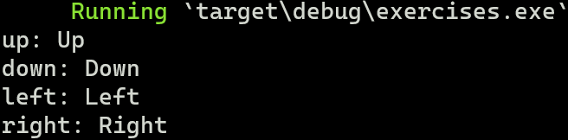
1/3
Does this example compile?
If yes, what does it print?
Simple Enum Direction with 4 Variants
match is exhaustive, it covers all 4 Variants
Syntax sugar for the impl type, here Direction
It compiles :)
Calls the above impl, with Direction::Up being self
©Philippe Felix Haupt 2023-2024

Slide 118
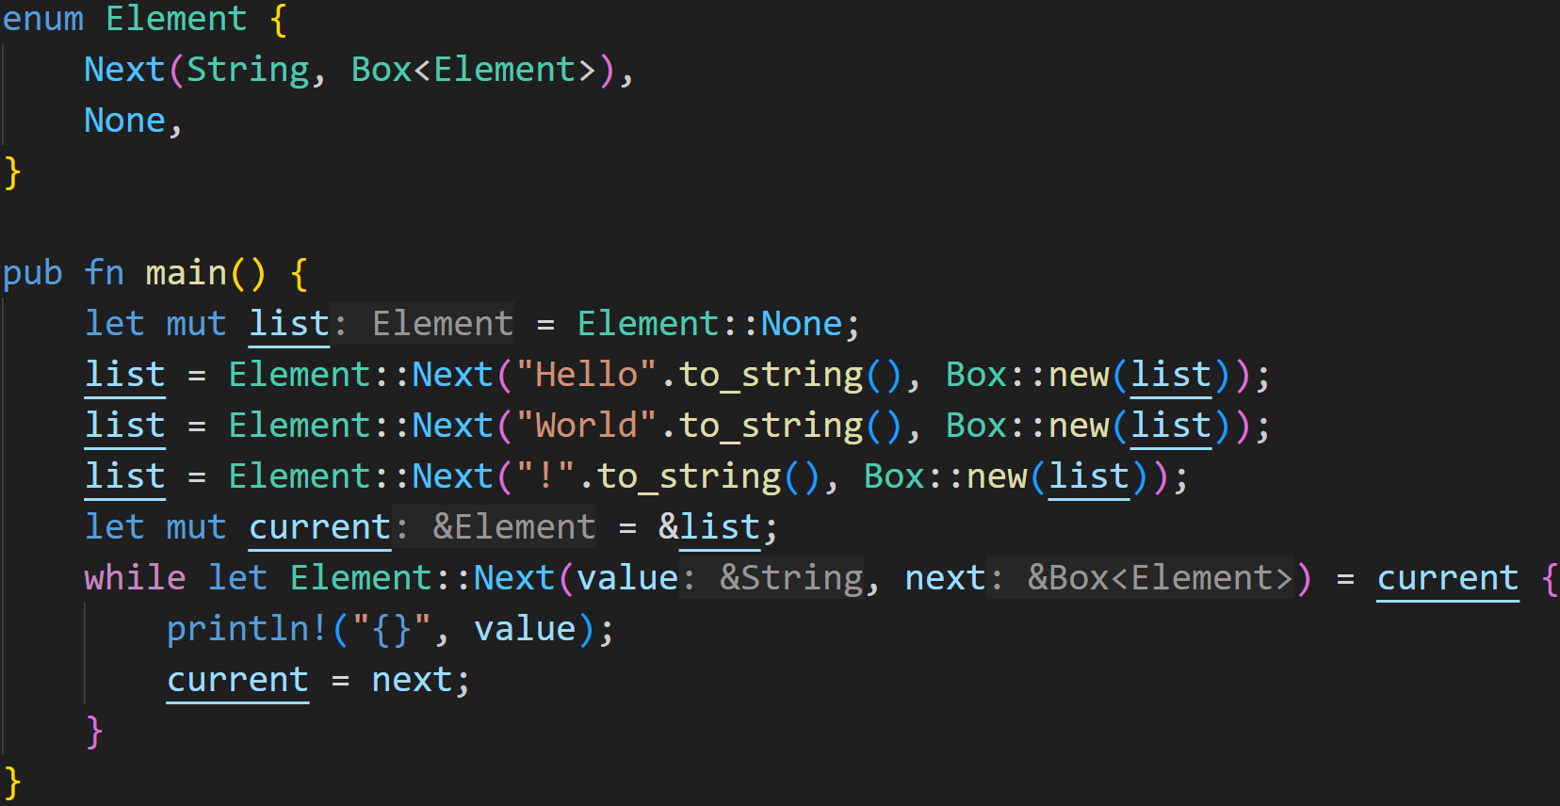
3/3
©Philippe Felix Haupt 2023-2024

Slide 119
Does this example compile?
If yes, what does it print?
3/3
©Philippe Felix Haupt 2023-2024

Slide 120
Does this example compile?
If yes, what does it print?
3/3
For advanced Enums, the size must be known at compile time, similar to structs, so this has to be boxed
©Philippe Felix Haupt 2023-2024

Slide 121
Does this example compile?
If yes, what does it print?
3/3
This moves list into a Box
But that’s fine, because we re-assign to list
©Philippe Felix Haupt 2023-2024

Slide 122
Does this example compile?
If yes, what does it print?
3/3
This moves list into a Box
But that’s fine, because we re-assign to list
Remember last time?
A Move is still Copying in the background, the “You can’t use this variable” Move-construct is a limitation enforced by Rust!
More specific, the limitation means that the variable (here list) acts as if it was uninitialized.
If you assign something to it before using it again, everything is fine :)
©Philippe Felix Haupt 2023-2024

Slide 123
Does this example compile?
If yes, what does it print?
Our list at that point:
!
World
None
Hello
©Philippe Felix Haupt 2023-2024

Slide 124
Does this example compile?
If yes, what does it print?
3/3
As we covered earlier, this let tries to match the pattern
©Philippe Felix Haupt 2023-2024

Slide 125
Does this example compile?
If yes, what does it print?
3/3
Rust offers more Pattern Matching Syntax:
while let pattern = expr {}
if let pattern = expr {}
As we covered earlier, this let tries to match the pattern
©Philippe Felix Haupt 2023-2024

Slide 126
Does this example compile?
If yes, what does it print?
3/3
Rust offers more Pattern Matching Syntax:
while let pattern = expr {}
if let pattern = expr {}
Both evaluate the let-statement, and if it matched successfully, evaluate the code block after, with the matched pattern being available inside that block
Here: We can use 2 variables value and next
As we covered earlier, this let tries to match the pattern
©Philippe Felix Haupt 2023-2024

Slide 127
Does this example compile?
If yes, what does it print?
3/3
This code basically means:
While there is a next element, print it and keep traversing the list, stopping once current is not Element::Next
©Philippe Felix Haupt 2023-2024

Slide 128
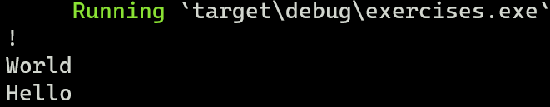
Does this example compile?
If yes, what does it print?
3/3
So, yes - This code compiles and runs successfully :)
©Philippe Felix Haupt 2023-2024

Slide 129
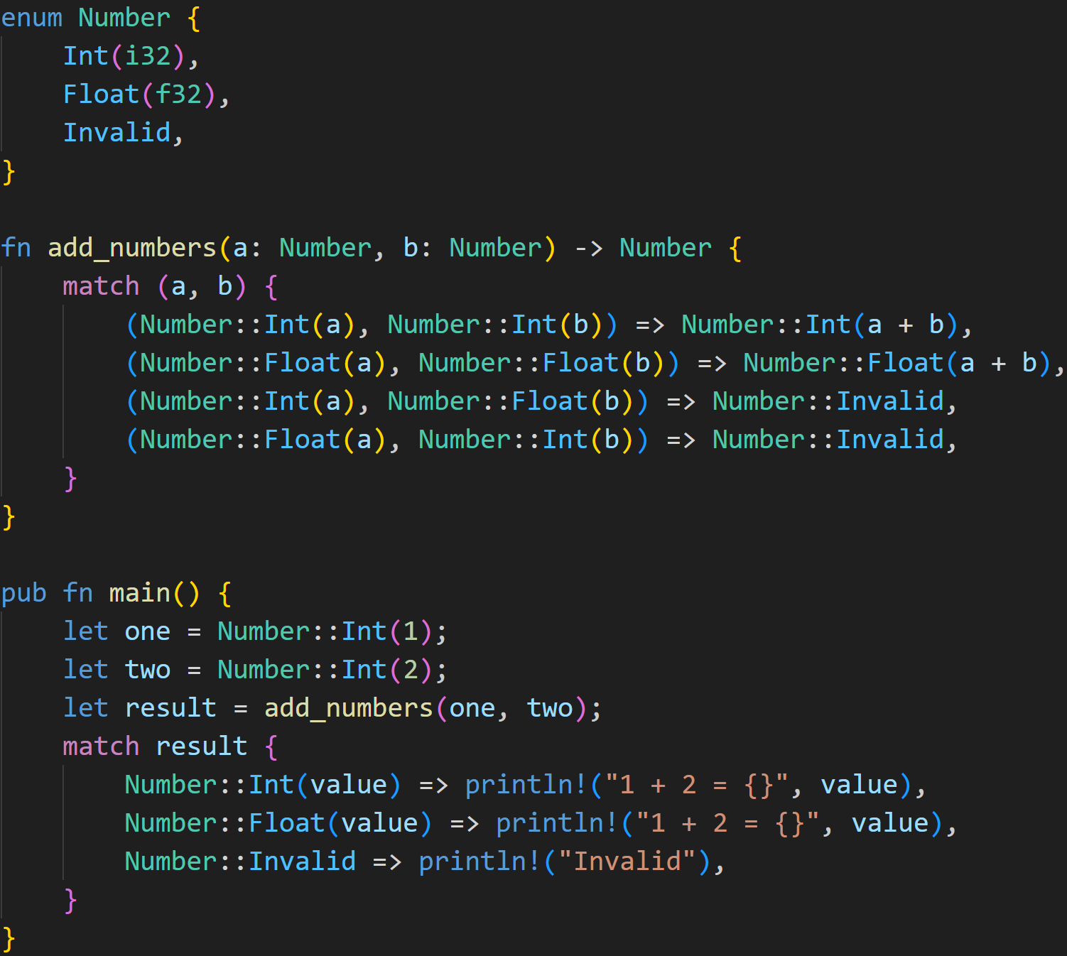
2/3
©Philippe Felix Haupt 2023-2024

Slide 130
2/3
Does this example compile?
If yes, what does it print?
©Philippe Felix Haupt 2023-2024

Slide 131
2/3
Does this example compile?
If yes, what does it print?
Enum Number with 3 Variants
©Philippe Felix Haupt 2023-2024

Slide 132
2/3
Does this example compile?
If yes, what does it print?
Enum Number with 3 Variants
You can match whatever expressions you want, including tuples like here
©Philippe Felix Haupt 2023-2024

Slide 133
2/3
Does this example compile?
If yes, what does it print?
Enum Number with 3 Variants
You can match whatever expressions you want, including tuples like here
Exhaustive match covers the result
©Philippe Felix Haupt 2023-2024

Slide 134
2/3
Does this example compile?
If yes, what does it print?
Enum Number with 3 Variants
However, this match is not exhaustive!
Exhaustive match covers the result
©Philippe Felix Haupt 2023-2024

Slide 135
2/3
Does this example compile?
If yes, what does it print?
Enum Number with 3 Variants
match-Statements are always exhaustive in Rust, which means they have to cover all possible Patterns.
However, this match is not exhaustive!
Exhaustive match covers the result
©Philippe Felix Haupt 2023-2024

Slide 136
2/3
Does this example compile?
If yes, what does it print?
Enum Number with 3 Variants
match-Statements are always exhaustive in Rust, which means they have to cover all possible Patterns.
The following Patterns are not handled:
(Number::Invalid, Number::Int(_))
(Number::Invalid, Number::Float(_))
(Number::Int(_), Number::Invalid)
(Number::Float(_), Number::Invalid)
(Number::Invalid, Number::Invalid)
However, this match is not exhaustive!
Exhaustive match covers the result
©Philippe Felix Haupt 2023-2024

Slide 137
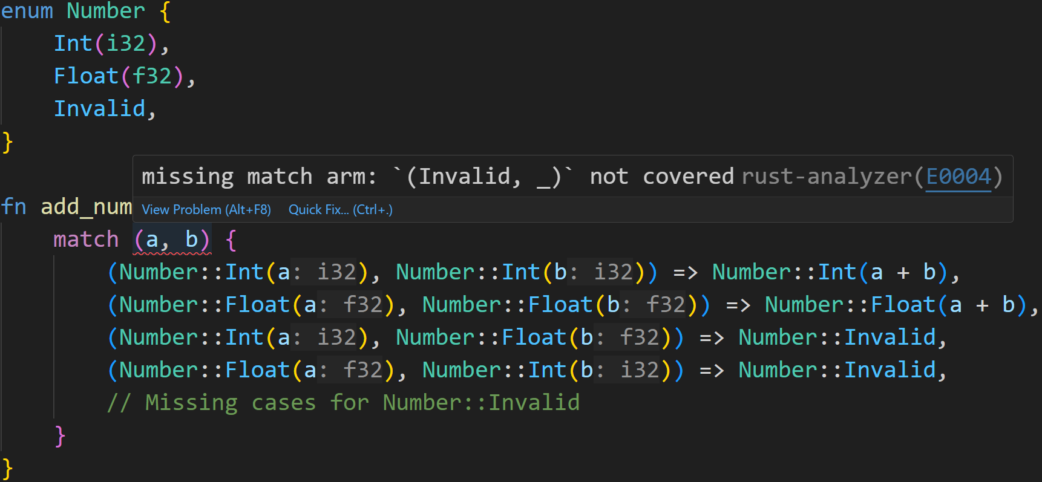
2/3
Does this example compile?
If yes, what does it print?
This code does not compile :(
©Philippe Felix Haupt 2023-2024

Slide 138
Next time
Generics
Option<T>
Result<T,E>
©Philippe Felix Haupt 2023-2024

